Slide 1


The History and Design Implications of Strong-Motion Instrumentation of Reinforced Concrete Structures in California
Jacob Morgan
May 8, 2024

Slide 2
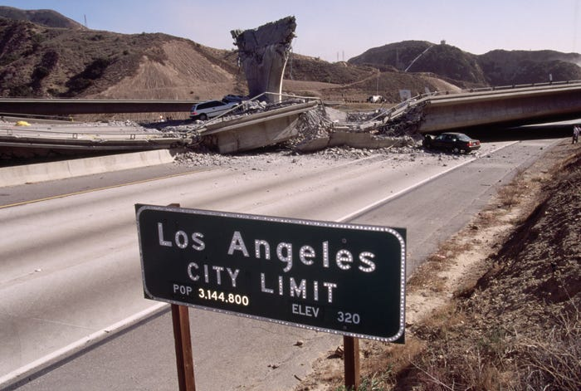
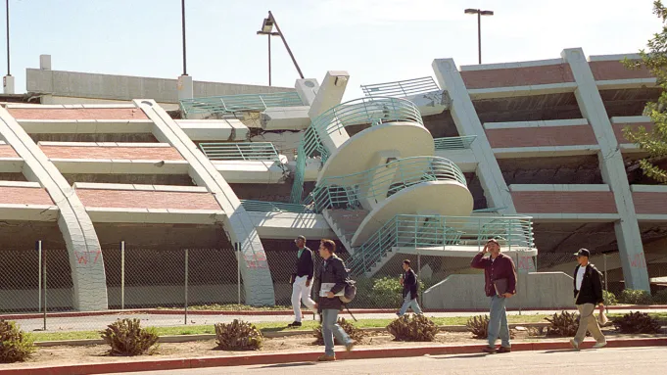
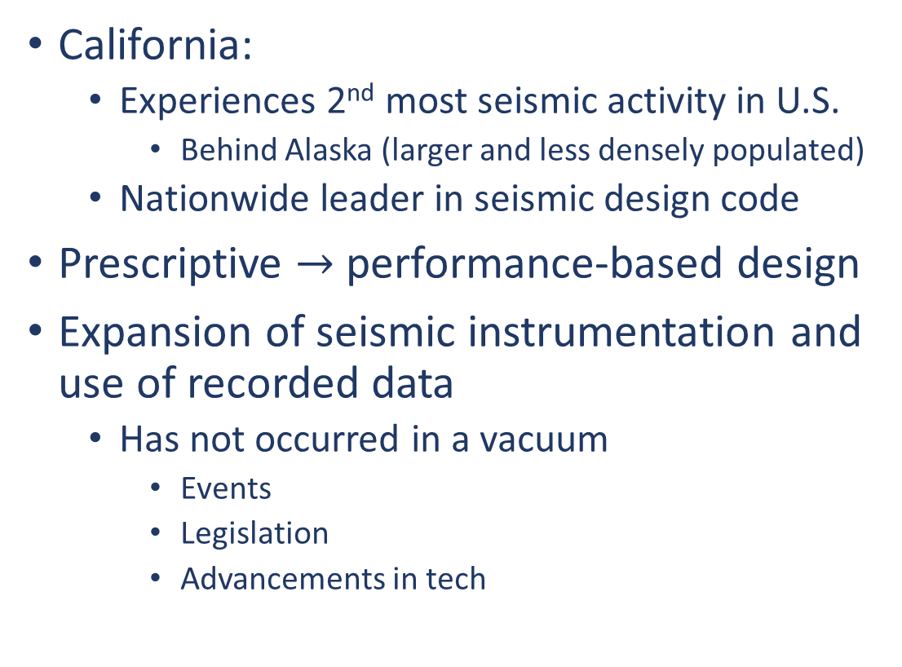
Motivation and Significance
California:
Experiences 2nd most seismic activity in U.S.
Behind Alaska (larger and less densely populated)
Nationwide leader in seismic design code
Prescriptive $→$performance-based design
Expansion of seismic instrumentation and use of recorded data
Has not occurred in a vacuum
Events
Legislation
Advancements in tech
https://www.hollywoodreporter.com/news/general-news/earthquake-20-years-northridge-how-670758/

Slide 3
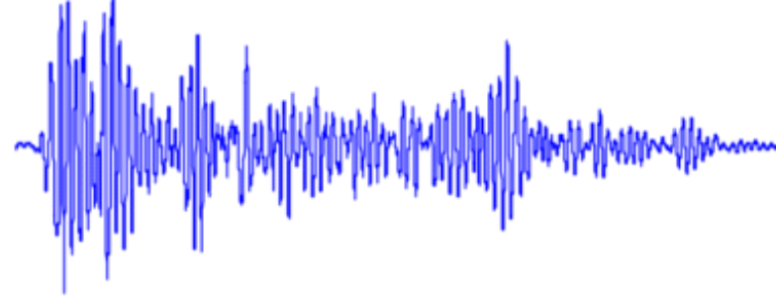
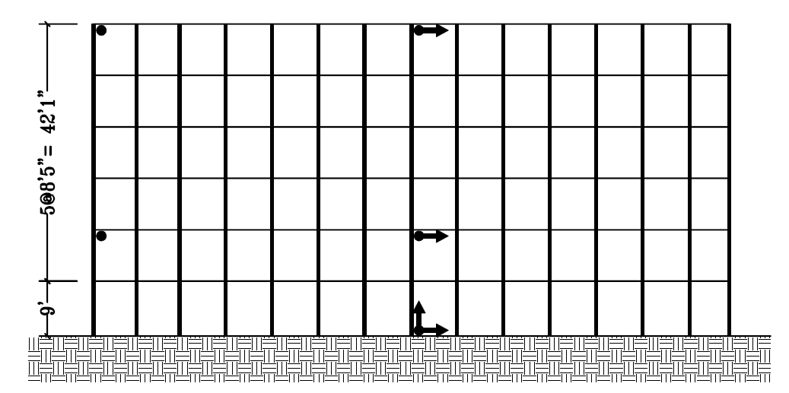
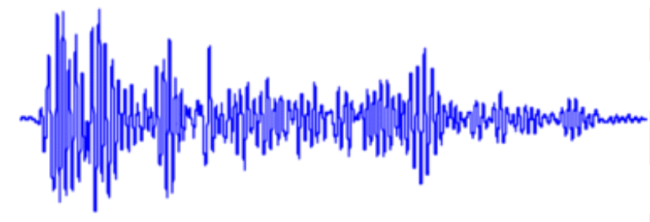
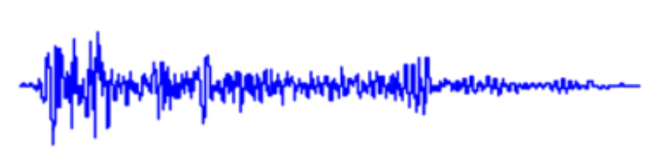
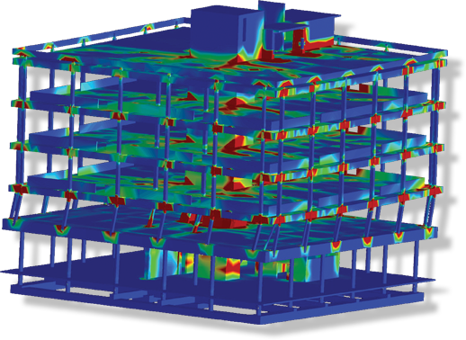
Objective
Understand:
What triggered the importance of instrumentation
How instrumentation motivates the advancement of design code
Answer key questions:
What precipitating events led to changes in design code?
Specific earthquakes? Specific structural failures?
How does this data translate to code revision?
https://www.extremeloading.com/earthquake-expo-2022-keynote-speaker-using-engineering-simulations-to-save-lives/

Slide 4
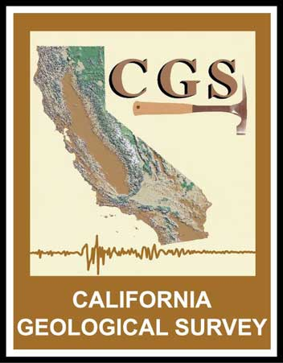







Approach
Literature review
Government reports
First-hand accounts of damage
Research studies
Design code revisions
Individual contribution
Is there an uptick in instrumentation after major events?
Does this align with legislation/code updates?

Slide 5
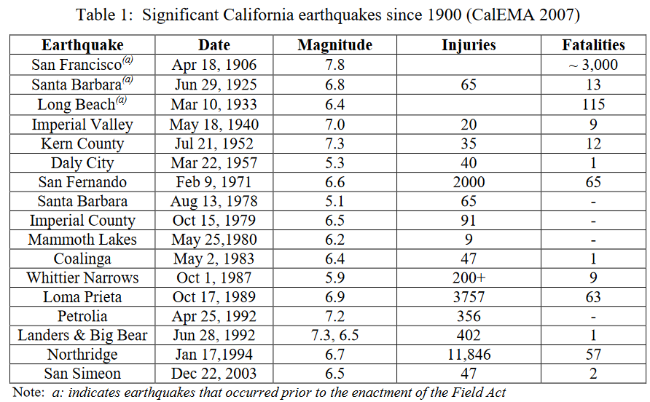
Major Earthquakes in California: 1900-2009
First accelerograph reading!
Source: State of California, Alfred E. Alquist Seismic Safety Commission
Notes:
Each of these earthquakes played a role in code development

Slide 6
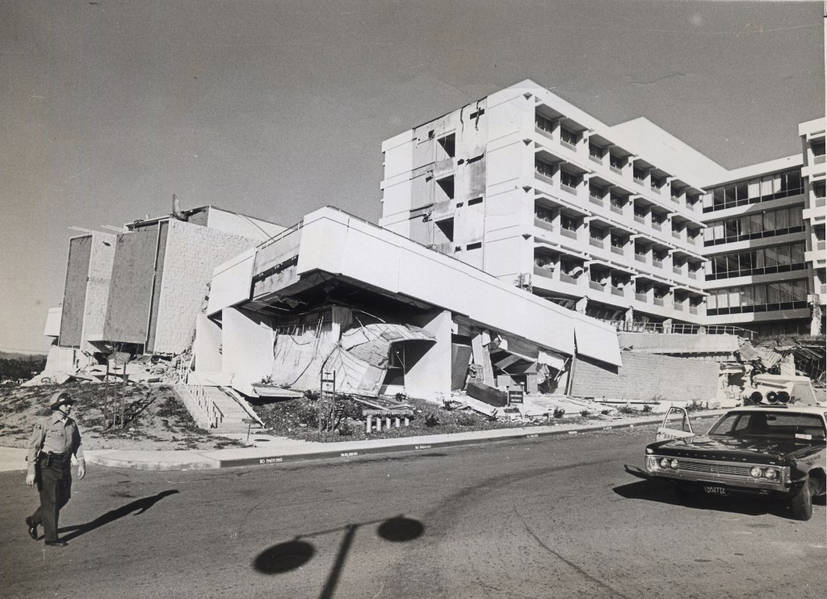
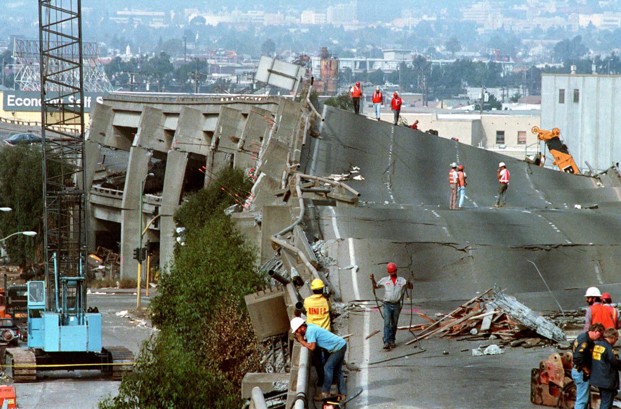
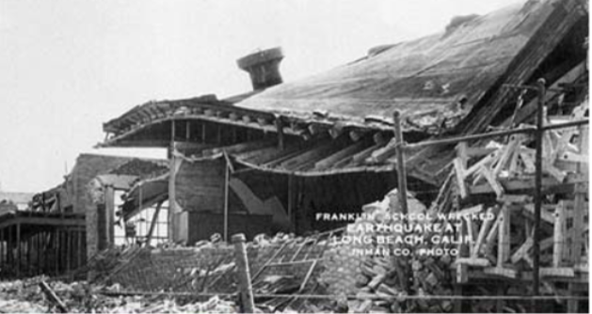
Changes to Design Code and Regulations
Code revisions target what failed in previous earthquakes
1933 Long Beach earthquake: Schools
1971 San Fernando earthquake: RC Buildings, dams (close calls)
1989 Loma Prieta earthquake: Bridges/highways, soft-story buildings
1994 Northridge earthquake: Steel moment frame welds, bridges/highways
Code formulae determined from databases of empirical data
Building material, building type, dimensions
1971
1989
1933

Slide 7
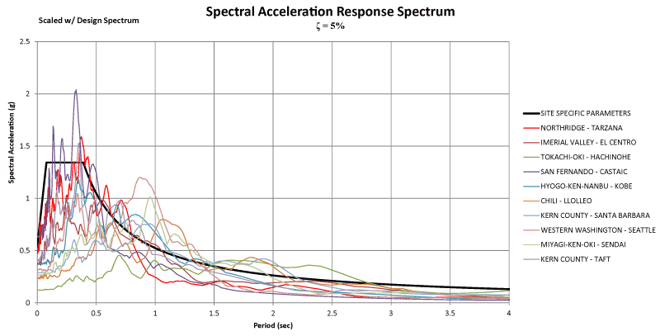
Changes to Design Code and Regulations
One code example: calculation of fundamental vibration period
Overestimating period results in underestimation of base shear
Lower period = higher acceleration = higher forces
V
V
Source: https://www.structuremag.org/?p=886

Slide 8
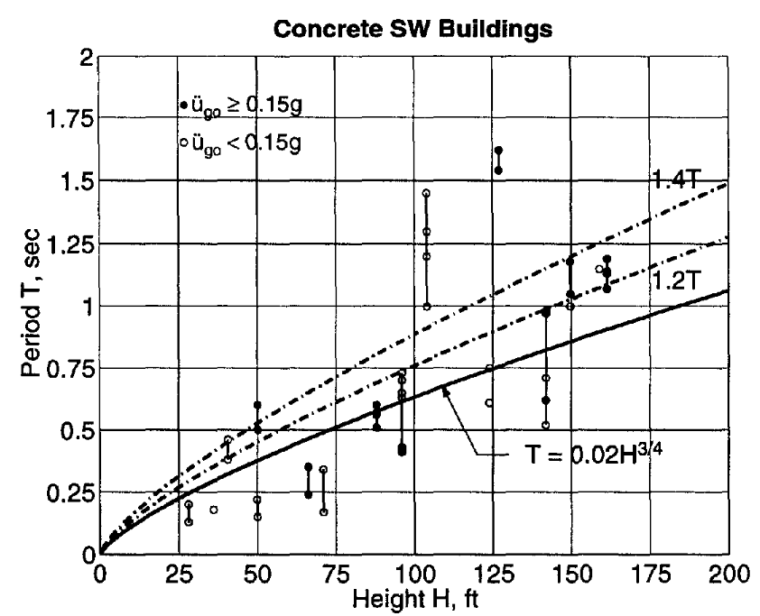
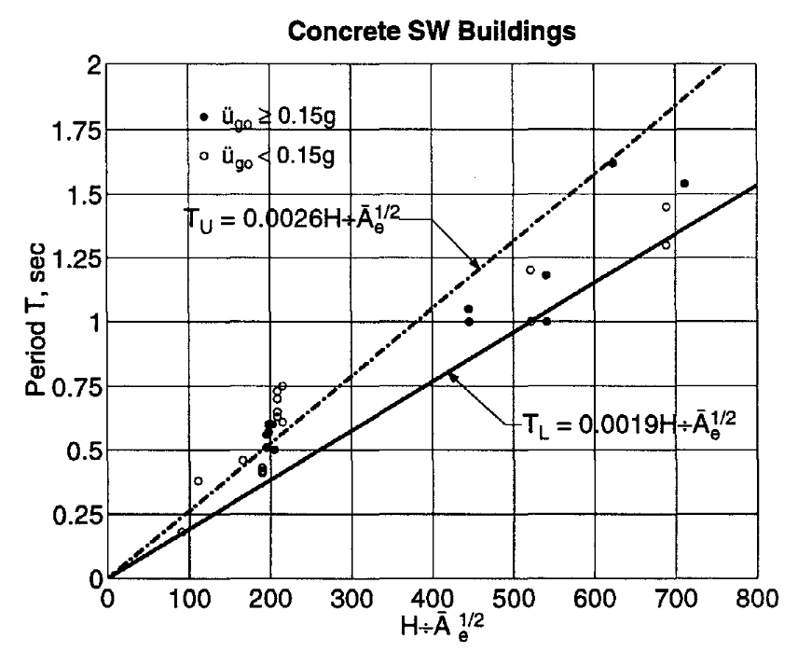
Changes to Design Code and Regulations
Design Code (UBC 97)
Period calculated as function of height
Periods below lower bound (dangerous)
Periods above upper bound (inefficient)
Regression Analysis (Goel and Chopra)
Normalize height by dimensions from plans
“Effective area”
Most periods between upper and lower bounds

Slide 9
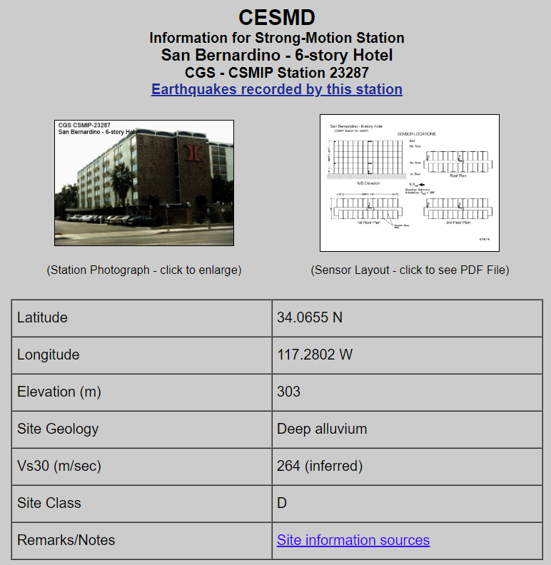
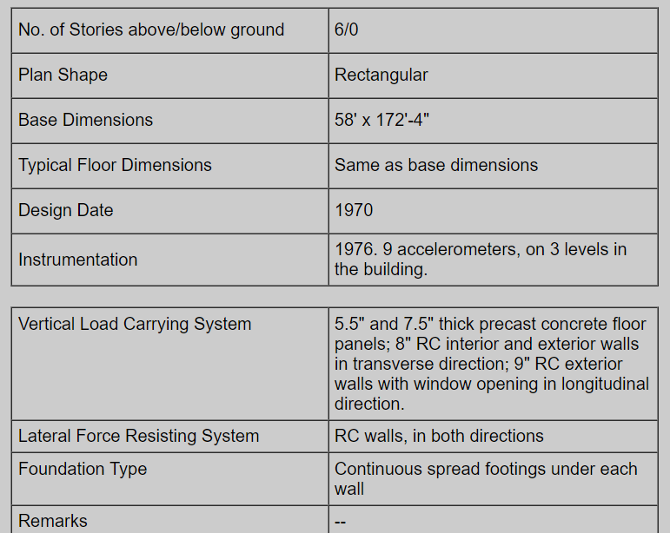
Original Contribution
Goal: compare instrumentation dates to major events/legislation
Each station has its own mini webpage
Some are incomplete with no data
Automated data collection
Python script “web scraping”
Categorize structure type
Organize structure types based on instrumentation year
Not complete for every structure

Slide 10
N = 353

Slide 11
Loma Prieta
earthquake
Northridge
earthquake
RC buildings most wide-spread
Increased focus on steel/composite braced frames and moment frames
Notes:
Trends: lots of dams, RC bldgs. In the early years
Other(usually steel) and composite buildings start to outnumber RC in the early 1990s

Slide 12
CSMIP/Caltrans Instrumentation Initiative begins
Loma Prieta earthquake
Northridge
earthquake
Notes:
Bridges pick up in the early 1990s, due to Caltrans/CSMIP agreement. Lots of overpasses

Slide 13
Conclusion
Strong-motion data played instrumental role in code development
Understanding earthquake motion and probabilistic nature of ground motion
Empirical data improved on code formulae
Trends in structural instrumentation show priorities
Impact of events not immediate, but visible
Priorities follow what failed in previous earthquakes
San Fernando: RC buildings and dams (close-calls)
Loma Prieta: Bridges
Northridge: Bridges, steel moment frames

Slide 14
References (1/2)
Christopher Arnold et al. Imperial County Services Building: Occupant Behavior and Operational Consequences as a Result of the 1979 Imperial Valley Earthquake. Technical Report PB83-145532. San Mateo, California: Building Systems Development, Inc., Aug. 1982.
D.M. Boore and J.J. Bommer. “Processing of strong-motion accelerograms: needs, options and consequences”. In: Soil Dynamics and Earthquake Engineering 25 (2005), pp. 93–115. doi: 10.1016/j.soildyn.2004.10.007.
California Geological Survey. California Strong Motion Instrumentation Program. California Department of Conservation. n.d. url: https://www.conservation.ca.gov/cgs/smi.
California Geological Survey. The 1989 Loma Prieta Earthquake. California Department of Conservation. n.d. url: https://www.conservation.ca.gov/cgs/earthquakes/loma-prieta.
Earthquake Science Center. M6.7 January 17, 1994 Northridge, California Earthquake. U.S. Geological Survey. 2024. url: https://www.usgs.gov/science/m67- january- 17- 1994- northridge-california-earthquake (visited on 03/20/2024).
Rakesh K. Goel and Anil K. Chopra. Vibration Properties of Buildings Determined from Recorded Earthquake Motions. Research Report UCB/EERC-97/14. Available from National Technical Information Service, U.S. Department of Commerce, Springfield, Virginia 22161. Richmond, CA: Earthquake Engineering Research Center, University of California, Berkeley, Dec. 1997. doi: Grant No.CMS9416265 from the National Science Foundation.
T. Heaton et al. “The TriNet Project”. In: Proc. of the 11th World Conference on Earthquake Engineering. Paper No. 2136. 1998. isbn: 0 08 042822 3.
William T. Holmes. “The Evolution of Seismic Design Provisions of U.S. Building Codes”. In: Proceedings of the 9th U.S. National and 10th Canadian Conference on Earthquake Engineering. 9th U.S. National and 10th Canadian Conference on Earthquake Engineering. Toronto, Ontario, Canada: Earthquake Engineering Research Institute, July 2010, Paper No 1657.
M.J. Huang and A.F. Shakal. “Analysis of Building Strong-Motion Records from the 1994 Northridge, California Earthquake”. In: Proceedings of the Eleventh World Conference on Earthquake Engineering. Amsterdam: Elsevier Science Ltd, 1996. isbn: 0 08 042822 3.19
M.J. Huang and A.F. Shakal. “Strong Motion Instrumentation of Seismically-Strengthened Port Structures in California by CSMIP”. In: Technical Council on Lifeline Earthquake Engineering Conference (TCLEE) 2009. Oakland, California, United States: American Society of Civil Engineers, 2009, pp. 1-9. doi: 10.1061/41050(357)99.
M.J. Huang and A.F. Shakal. “Structure Instrumentation in the California Strong Motion Instrumentation Program”. In: Strong Motion Instrumentation for Civil Engineering Structures. Ed. by M. Erdik et al. Dordrecht: Springer Netherlands, 2001, pp. 17–31. doi: 10.1007/978-94-010-0696-5_2.
R.A. Page, D.M. Boore, and R.F. Yerkes. The Los Angeles Dam Story. U.S. Geological Survey. 1995. url: https://pubs.usgs.gov/fs/1995/0096/.
R. Shepherd and A. W. Plunkett. “Damage Analyses of Imperial County Services Building”. In: Journal of Structural Engineering 109.7 (1983), pp. 1711–1726.
State of California, Alfred E. Alquist Seismic Safety Commission. The Field Act and its Relative Effectiveness in Reducing Earthquake Damage in California Public Schools. No. CSSC-09. Sacramento, California: Seismic Safety Commission, Oct. 2009.

Slide 15
References (2/2)
Structural Engineers Association of California. Recommended Lateral Force Requirements and Commentary. San Francisco, CA: SEAOC, 1960.
M.D. Trifunac, S.S. Ivanovi ́c, and M.I. Todorovska. Instrumented 7-Storey Reinforced Concrete Building in Van Nuys, California: Description of Damage from the 1994 Northridge Earthquake and Strong Motion Data. Technical Report CE 99-02. Los Angeles, California: University of Southern California, Department of Civil Engineering, July 1999.
U.S. Geological Survey. M 6.9 - The 1989 Loma Prieta, California Earthquake. n.d. url: https ://earthquake.usgs.gov/earthquakes/eventpage/nc216859/impact.
U.S. Geological Survey. NSMP History. 2024. url: https://earthquake.usgs.gov/monitoring/nsmp/history/.
U.S. Geological Survey. The Northern California Earthquake, April 18, 1906. n.d. url: https://earthquake.usgs.gov/earthquakes/events/1906calif/virtualtour/earthquake.php.

Slide 16
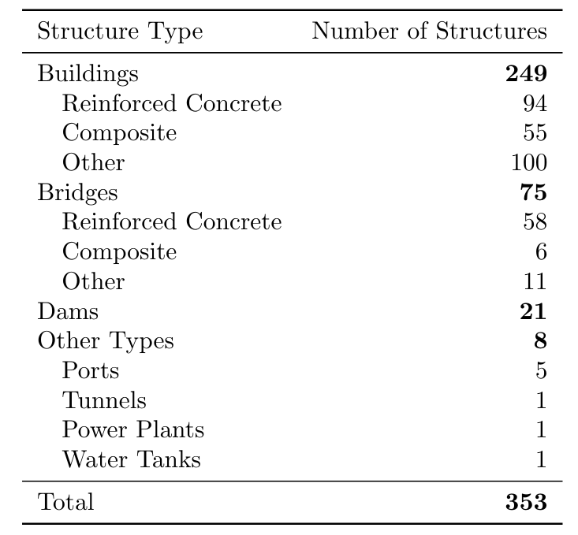
Appendix A: Structures by Type

Slide 17
Appendix B: Dam Instrumentation Years
Notes:
Trends: lots of dams, RC bldgs. In the early years
Bridges pick up in the early 1990s, due to Caltrans/CSMIP agreement. Lots of overpasses
Other(usually steel) and composite buildings start to outnumber RC in the early 1990s

